Slide 1

moose for dcs world CARGO for Armoured personel carriers

Slide 2
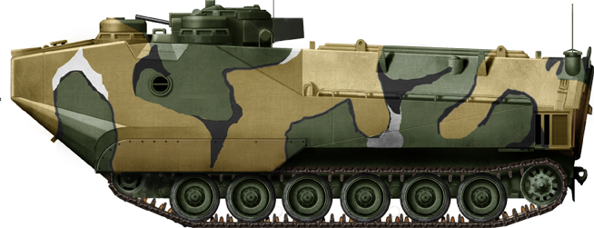
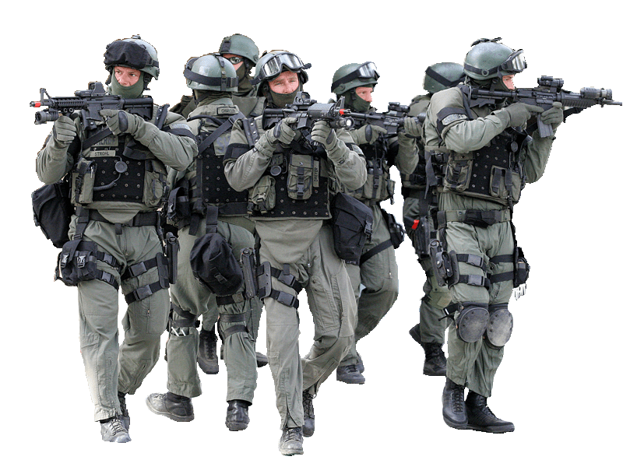
features
Pickup Coordinate
Board Cargo
route apc to pickup / deploy coordinates.
the apc follows the roads between pickup and deploy routes.
transports a cargo set.
combine different cargo types: infantry, mortars, manpads.
handles apc groups consisting of multiple apc units.
infantry unboards apc in case of enemy presence.
capture loaded / unloaded events and customize actions.
build chains of cargo handling actions.
easily build repeated cargo transportation workflows.
Road
Deploy Coordinate
Unboard Cargo

